Slide 1

DDC NOT-FOR-PROFIT
REIMBURSEMENT PROGRAM (NRP)
INFORMATION FORUM
MARCH 1, 2021
Jamie Torres-Springer
First Deputy Commissioner
David J. Varoli, Esq.
Deputy Commissioner, Law Division, & General Counsel

Slide 2

Welcome
TODAY’S SPEAKERS
David Varoli
Irene Kaptzis
Kathy Tuznik
2

Slide 3
Introduction
What is DDC?
My project is in the city budget, so how did it get here?
When do I get my money?
3

Slide 4
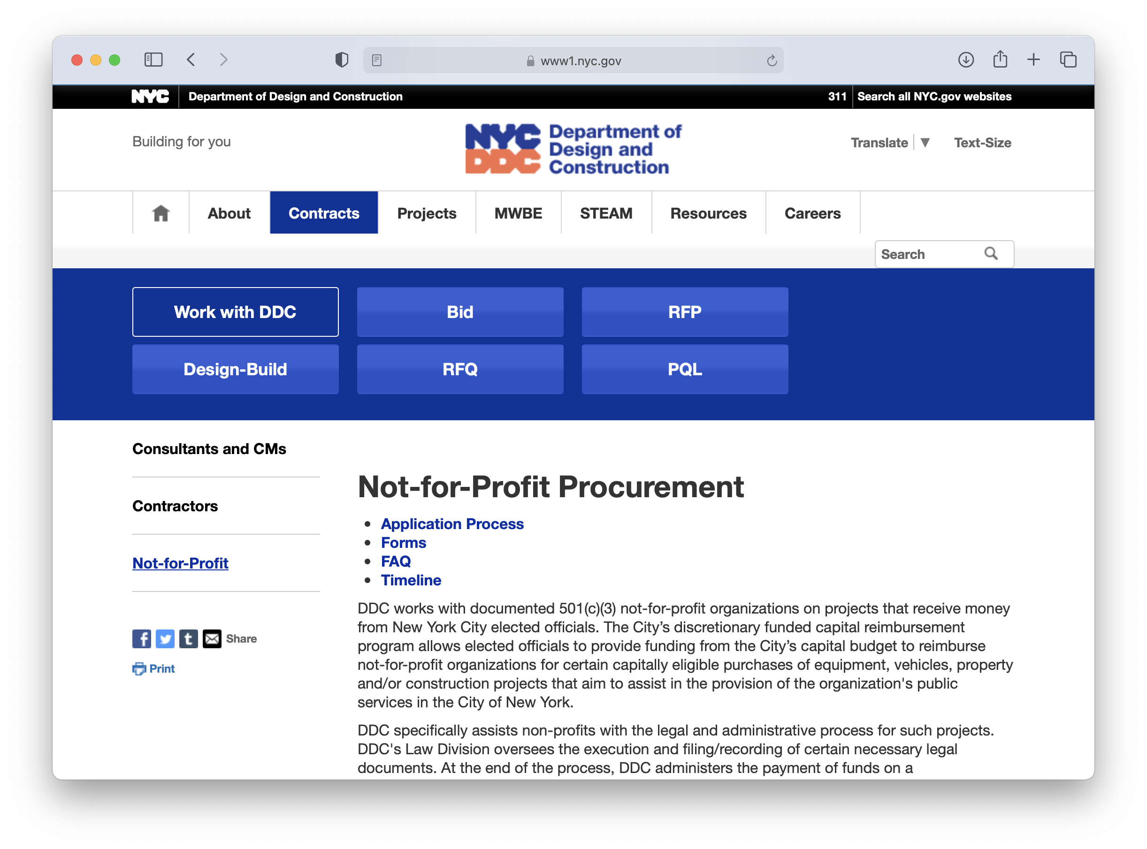
DDC’s NRP WEBSITE
https://www1.nyc.gov/site/ddc/contracts/not-for-profit-forms.page
4

Slide 5

NRP Legal Requirements:
NYS Law on Secured Transactions: Art. 9 of the Uniform Commercial Code (UCC-1 for Equipment) (DMV Lien for Vehicles)
NYC Charter & NYC Comptroller Directive #10
NYS Local Finance Law - Section 11
5

Slide 6

Main Contractual Requirements:
Funding Agreement:
  5 Year Use Required Typically
  City Purpose Covenant
  Non-Discrimination Affirmation
Security Agreement:
  Establishes City’s Lien Interest
6

Slide 7
The Capital Funding Process:
Funding Allocation
Budget & Legal Review
Pre-CP Review
CP Approval
NYC
Comptroller
Registration
Payment Requisition
Reimbursement
7

Slide 8

DDC Law’s 3 Checklist Approach:
Budget & Pre-CP Review
Registration
Payment
8

Slide 9

Five Common Pitfalls:
Upfront purchase costs ​
Procurement requirements
Non-transferable software ​
Minimally attached equipment
UCC lien clearance
9

Slide 10

Next Steps:
1. Review DDC’s NRP Handbook
and website for more details.
2. Complete all checklist items for
each project stage.
10

Slide 11
Thank you for joining us on this webinar.
DDC Law is here to help.
Let’s keep in touch.
Q & A
11

